Slide 1


RICTOR Domain Diagram H.Sapiens Reference
57
439
743
857
1084
1190
RICTORN
RICTORM
RasGEF
Domain5
RICTOR Phosphorylation
523
742
926
992
ARM-Repeats

Slide 2
57
439
743
857
1084
1190
RICTORN
RICTORM
RasGEF
Domain5
RICTOR Phosphorylation
523
742
926
992
ARM-Repeats

Slide 3
Secondary Endosymbiosis Event
SAR
Amorphea
Archaeplastida
Ciliates
Ochrophyta
Alveolata
Apusomonada
Chlorophyta
Stramenopiles
Breviates
Streptophyta
Rhizaria
Rhodophyta
Opisthokonta
Amoebozoa
Discoba
Secondary Endosymbiosis Event
Metamonada
Euglena gracilis
Primary Endosymbiosis
Event
Excavata

Slide 4


Slide 5

SIN1
RICTOR
RAPTOR
LST8
TOR

Slide 6
TOR Complex 1
TOR Complex 2
RICTOR
RAPTOR
TOR
SIN1
TOR
LST8
LST8

Slide 7

Metamonada
Opisthokonta
Amoebozoa
Discoba
Rhizaria
Streptophyta
Alveolata
Stramenopila
Rhodophyta
Chlorophyta

Slide 8
Workflow/Pipeline
NCBI/JGI Genomic Information
MSA
Phylogenetic Tree(s)
Results/TOR Complex Patterns
BUSCO/HMMER/BLAST
R Tables & Taxonomy Tables
Graphs/Data Table
SRA /Diamond Alignment
Notes:
We need to add a start point. Have something that asks the question; what organisms have TORC2 Components and TORC1 Components?

Slide 9
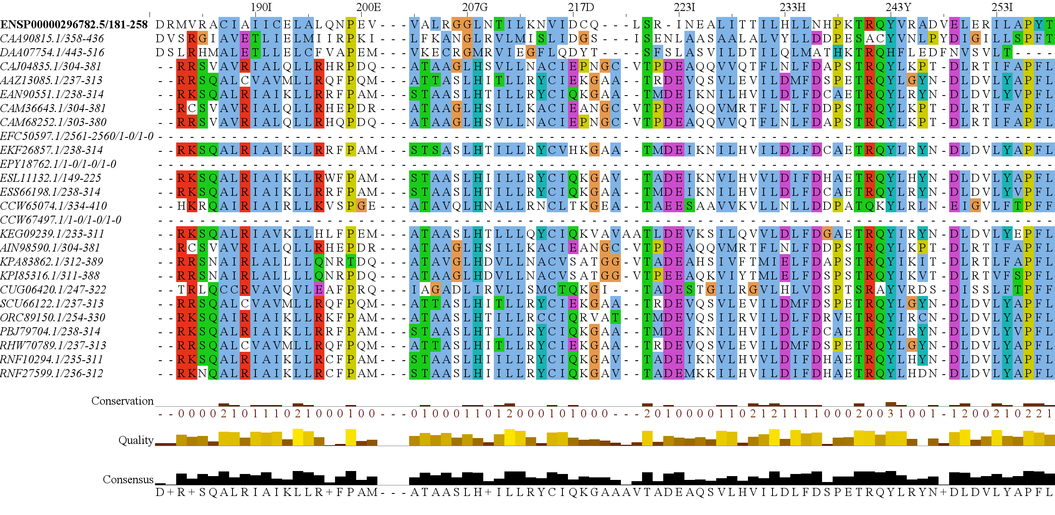
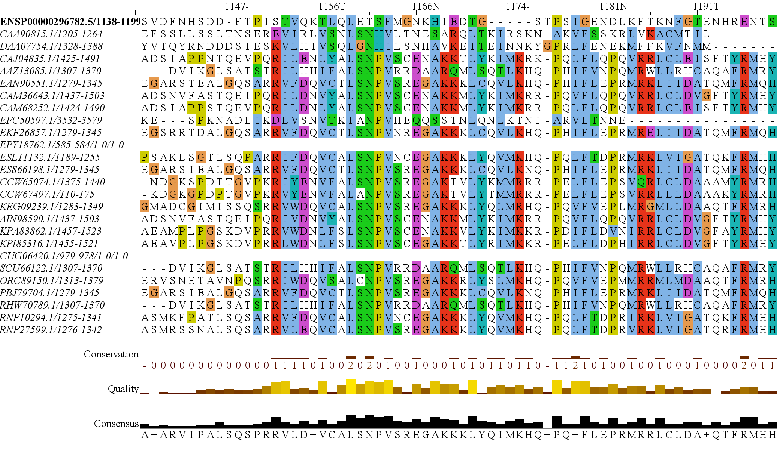
RICTORN
RICTORM
RasGEF
Domain5
RICTOR Phosphorylation
ARM Repeats

Slide 10
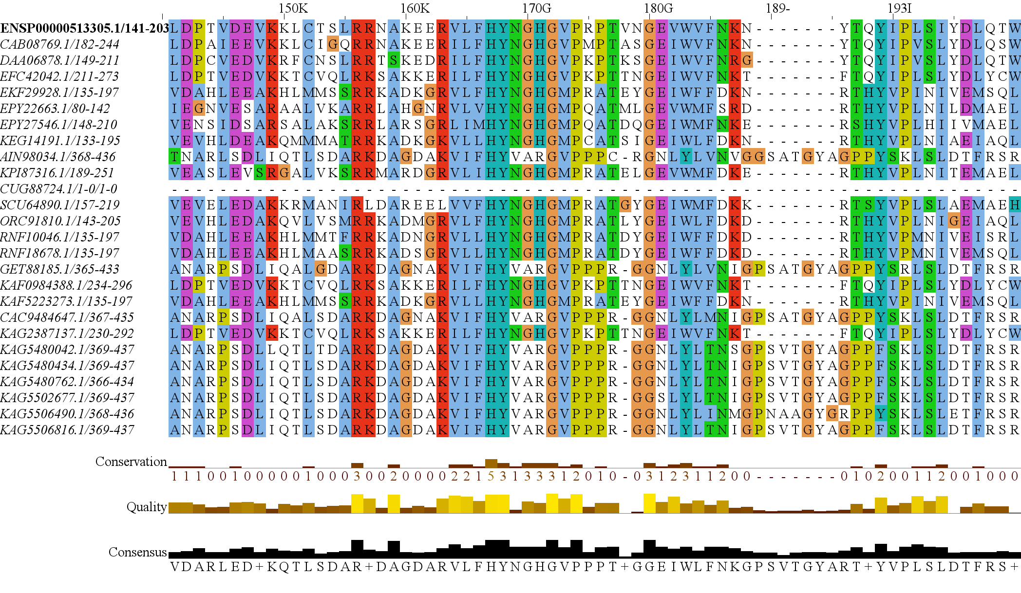
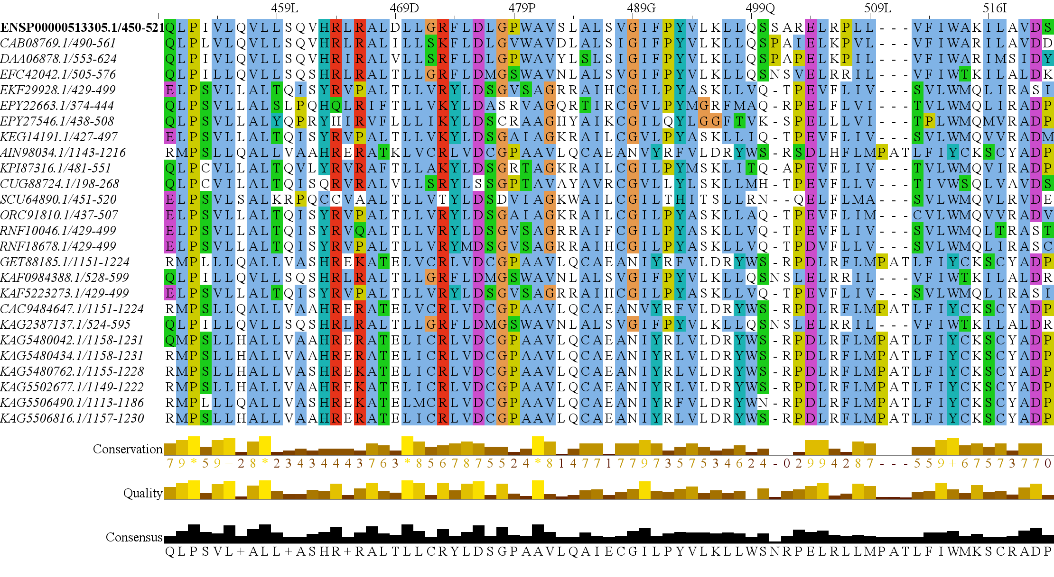
RAPTORN
ARM Repeats
HEAT
ARM Repeats
WD-40 Repeats

Slide 11



Slide 12
SARs gain of plastids and the losses of TOR Complexes
Rhodophyta Endosymbiosis
Bacillariophyta
TORC2 Lost
PX Clade
Stramenopila
Eustigmatales, etc.
Oomycetes, etc.
Expected Heterotrophic Ancestor
TORC1 & TORC2 Present
Stramenopile Endosymbiosis
Dinophyceae
Chromera, Vitrella
Alveolata
Apicomplexa
Ciliates, etc.
Photoautorophy Loss
Granofilosa
TORC1 and TORC2 Lost
Chlorarachnea
TORC1 Lost
Rhizaria
Chlorophyta Endosymbiosis
Endomyxa, etc.

Slide 13
Simplified Excavata Gain of Plastids
Chlorophyta Endosymbiosis
Euglenophyceae
Discoba
Kinetoplastea
Eutetramitia, etc.
Expected Heterotrophic Ancestor
TORC1 & TORC2 Present
Metamonada

Slide 14
Granofilosa
Reticulofilosa
Filosa
Chlorarachnea
Cercozoa
Monadofilosa
Endomyxa, etc
Rhizaria
Chlorophyta Endosymbiosis
Retaria

